Slide 1


Kumar Arpit
March 4, 2025

Slide 2

Outline
Executive Summary
Introduction
Methodology
Results
Conclusion
Appendix

Slide 3
Executive Summary
Summary of methodologies:
The research outlines a step-by-step approach to predicting the landing success of the SpaceX Falcon 9 first stage. It begins with data collection, followed by web scraping historical launch records from Wikipedia. The extracted data is then processed through various cleaning and transformation steps, including handling missing values, extracting key attributes (such as booster version, payload mass, launch site, and landing outcome), and converting data into a structured format using Pandas. Filtering is applied to retain only Falcon 9 launches, and numerical attributes are normalized. Finally, the processed data is exported for further analysis.
Summary of all results:
The final dataset provides a cleaned and structured record of Falcon 9 launches, including flight numbers, launch dates, payload masses, orbits, and landing outcomes. It captures details such as whether the booster successfully landed, the type of landing, and key attributes of the rocket's core (e.g., reuse count, grid fins, and landing pad). The data shows trends in launch success, improvements in booster recovery over time, and payload variations across missions. Additionally, missing payload mass values were replaced with the mean, ensuring data consistency.

Slide 4
Introduction
Project background and context:
This project focuses on predicting the landing success of the SpaceX Falcon 9 first stage, a critical factor in reducing launch costs through rocket reusability. SpaceX's ability to recover and reuse boosters significantly lowers launch expenses compared to competitors. By analyzing historical launch data, the project aims to understand patterns in successful landings and improve predictive models for future missions. Data is gathered from SpaceX’s API and Wikipedia, followed by processing and structuring to extract meaningful insights.
The primary objective is to determine what factors contribute to a successful Falcon 9 booster landing. Key questions include:
How does payload mass impact landing success?
Does the launch site influence landing outcomes?
What role do booster characteristics (e.g., grid fins, landing legs, reuse count) play in successful recoveries?
How has the success rate of landings improved over time?
By answering these, the project aims to enhance understanding of SpaceX's landing reliability and assist in cost estimation for future launches.

Slide 5

Section 1

Slide 6
Methodology
Executive Summary
Data collection methodology:
Data was gathered using API requests and web scraping. The SpaceX API provided historical launch details, including rocket IDs, launchpad locations, payload data, and core attributes. Additional API calls retrieved specific details like booster versions, payload mass, and landing outcomes. Web scraping was used to extract launch records from Wikipedia, parsing HTML tables with BeautifulSoup to collect flight numbers, launch dates, customers, and landing results. The collected data was then cleaned, structured, and prepared for analysis.
Perform data wrangling:
The collected data underwent cleaning and transformation to ensure consistency and usability. Missing values in key columns, such as payload mass, were replaced with the mean, while categorical values were standardized. API-extracted IDs were converted into meaningful attributes like booster versions, launch sites, and orbit types. Rows with multiple cores or payloads were removed to maintain uniformity. Dates were formatted for better analysis, and only Falcon 9 launches were retained. The final cleaned dataset was structured into a Pandas DataFrame and exported as a CSV file for further exploration.

Slide 7
Methodology
Executive Summary
Perform exploratory data analysis (EDA) using visualization and SQL
Data was plotted to analyze trends in landing success, payload distribution, and launch site performance. Scatter plots, bar charts, and heatmaps were used to identify correlations between payload mass and landing outcomes. SQL queries were used to filter and group data, extracting insights on launch success rates, booster reuse performance, and mission frequencies across different launch sites. Aggregations helped in identifying trends in payload mass, orbit types, and landing success over time.
Perform interactive visual analytics using Folium and Plotly Dash
Folium used to create interactive maps, visualizing launch site locations along with successful and failed landings. Markers and pop-ups provided details on each launch, helping analyze geographic trends. Plotly Dash developed interactive dashboards with dynamic charts and filters to explore relationships between payload mass, orbit type, and landing success. Users could adjust parameters and visualize real-time data updates through scatter plots, histograms, and pie charts.

Slide 8
Methodology
Executive Summary
Perform predictive analysis using classification models
Predictive analysis was conducted using classification models to predict the success of Falcon 9 first-stage landings.
Model Building: Features such as payload mass, launch site, booster reuse, and orbit type were selected. Data was preprocessed and split into training and testing sets.
Model Tuning: Various classification models, including Logistic Regression, Decision Trees, and Support Vector Machines, were trained and optimized using hyperparameter tuning techniques like GridSearchCV.
Model Evaluation: Accuracy, precision, recall, and F1-score were used to assess model performance. Confusion matrices and ROC curves helped compare model effectiveness in predicting landing outcomes.
This approach enabled the identification of the best-performing model for predicting successful landings.

Slide 9
Data Collection
The data collection process involved two primary methods: API requests and web scraping, followed by data extraction and transformation. Below is a structured breakdown of the process with key phrases:
API Requests (SpaceX API)
Requesting Data: Used requests.get() to retrieve SpaceX launch data from https://api.spacexdata.com/v4/launches/past.
Extracting Key Attributes: Retrieved rocket, launchpad, payloads, and cores details.
Enhancing Data: Used additional API calls to get booster versions, payload masses, orbit types, and landing outcomes.
2. Web Scraping (Wikipedia Page)
Target Source: https://en.wikipedia.org/wiki/List_of_Falcon_9_and_Falcon_Heavy_launches.
Extracting Launch Data: Used BeautifulSoup to parse HTML tables containing Falcon 9 launch details.
Cleaning Data: Removed unnecessary tags and extracted key details like flight number, launch site, customer, payload mass, and landing success.
3. Data Transformation and Storage
Data Structuring: Converted raw API and web-scraped data into a structured Pandas DataFrame.
Cleaning & Preprocessing: Standardized column values, handled missing data, and removed duplicate entries.
Exporting Data: Stored final dataset as CSV for further analysis.

Slide 10
Data Collection – SpaceX API
Request Data from API
Extract Rocket, Payload & Core Info
Fetch Additional Details via API
Web Scrape Falcon 9 Launch Data
Extract Tables & Parse HTML Content
Parse API Responses & Transform Data (Pandas)
Handle Missing Values & Duplicates
Export Clean Data (CSV Format)
The data collection process utilized SpaceX REST API calls to retrieve detailed launch data.
You can find all the completed API calls along with Jupyter notebook by clicking on the link here.
You can also find a flowchart representing the entire API process on the right side.

Slide 11
Data Collection - Scraping
Send HTTP Request to Wikipedia Page
Parse HTML Using BeautifulSoup
Locate and Extract Falcon 9 Launch Table
Extract Column Headers & Launch Data Rows
Clean and Structure Data in Pandas DataFrame
Handle Missing Values & Standardize Entries
Save Cleaned Data as CSV File for Analysis
The web scraping process was used to extract Falcon 9 launch data from Wikipedia.
You can find all the completed web scraping process along with Jupyter notebook by clicking on the link here.
You can also find a flowchart representing the entire web scraping process on the right side.

Slide 12
Data Wrangling
The data wrangling process focused on cleaning, transforming, and structuring the collected SpaceX Falcon 9 launch data for analysis. Below is a structured breakdown with key phrases and a flowchart representation.
You can find all the completed data wrangling process along with Jupyter notebook by clicking on the link here.
You can also find a flowchart representing the entire data wrangling process on the right side.
Identify & Handle Missing Data
Standardize Date & Column Names
Filter Falcon 9 Launches
Extract & Flatten Nested JSON Data
Convert Lists to Separate Columns
Reset Flight Numbers Sequentially
Save Cleaned Data as CSV File

Slide 13
EDA with Data Visualization
Various charts were plotted to analyze key trends in SpaceX Falcon 9 launch data. Scatter plots examined the relationship between payload mass and landing success, while bar charts compared landing success rates across different launch sites. Pie charts visualized the proportion of successful vs. failed landings, and heatmaps highlighted correlations between payload mass, reuse count, and landing success. Line charts tracked improvements in booster landings over time, while histograms displayed the distribution of payload masses. These visualizations provided valuable insights into landing success factors, payload effects, launch site performance, and historical trends, enabling a deeper understanding of SpaceX’s mission outcomes.
You can find all the completed EDA process along with Jupyter notebook by clicking on the link here.

Slide 14
EDA with SQL
Summary of SQL Queries Performed
Retrieve All Launch Records
SELECT * FROM launches;
Fetched all launch data for initial exploration.
Count of Successful and Failed Landings
SELECT outcome, COUNT(*) FROM launches GROUP BY outcome;
Determined the number of successful vs. failed landings.
Filter Falcon 9 Launches Only
SELECT * FROM launches WHERE BoosterVersion = 'Falcon 9’;
Isolated Falcon 9 launch data for focused analysis.

Slide 15
EDA with SQL
Summary of SQL Queries Performed
Landing Success Rate by Launch Site
SELECT LaunchSite, COUNT(*) AS total_launches, SUM(CASE WHEN Outcome LIKE 'True%' THEN 1 ELSE 0 END) AS successful_landings FROM launches GROUP BY LaunchSite;
Analyzed landing success rates per launch site.
Average Payload Mass for Successful and Failed Landings
SELECT Outcome, AVG(PayloadMass) FROM launches GROUP BY Outcome;
Compared payload mass for successful vs. failed landings.
Most Frequently Used Booster Versions
SELECT BoosterVersion, COUNT(*) FROM launches GROUP BY BoosterVersion ORDER BY COUNT(*) DESC;
Identified the most commonly used booster versions.

Slide 16
EDA with SQL
Summary of SQL Queries Performed
Success Rate Over Time
SELECT strftime('%Y', Date) AS Year, COUNT(*) AS Total_Launches, SUM(CASE WHEN Outcome LIKE 'True%' THEN 1 ELSE 0 END) AS Successful_Landings FROM launches GROUP BY Year ORDER BY Year;
Tracked landing success trends over the years.
Top 5 Heaviest Payloads and Their Outcomes
SELECT PayloadMass, Outcome, BoosterVersion FROM launches ORDER BY PayloadMass DESC LIMIT 5;
Analyzed the impact of the heaviest payloads on landing success.
These SQL queries helped uncover key insights into landing success factors, payload effects, booster performance, and historical trends in SpaceX Falcon 9 launches. You can find all the completed SQL queries along with Jupyter notebook by clicking on the link here.

Slide 17
Build an Interactive Map with Folium
Summary of Folium Map Objects and Their Purpose
The interactive Folium map included various objects to visualize SpaceX Falcon 9 launch data effectively. Markers were placed at each launch site to show locations, with popups displaying launch details on click. Color-coded circles (Green for success, Red for failure) represented landing outcomes, making it easy to identify successful missions. Lines connected launch sites to landing pads, illustrating booster flight paths, while a heatmap highlighted launch frequency at different sites. These elements provided an intuitive way to analyze launch site activity, landing success, and mission trajectories.
You can find the interactive map with Folium in the Jupyter notebook by clicking on the link here.

Slide 18
Build a Dashboard with Plotly Dash
Summary of Plotly Dash Dashboard
The Plotly Dash dashboard included interactive scatter plots, bar charts, pie charts, and histograms to explore SpaceX Falcon 9 launch data dynamically. A scatter plot was used to analyze the relationship between payload mass and landing success. A pie chart visualized the proportion of successful vs. failed landings. The dashboard featured dropdowns and sliders to filter data by launch site, payload range, and year, allowing users to adjust parameters and view real-time updates. These interactive elements provided a deeper understanding of key launch factors, success rates, and payload impacts in an engaging and user-friendly format.
You can find the Plotly Dash Dashboard in the Jupyter notebook by clicking on the link here.

Slide 19
Predictive Analysis (Classification)
Summary of Predictive Model Development
The classification model was built to predict the success of Falcon 9 first-stage landings using machine learning algorithms. The process began with data preprocessing, where missing values were handled, categorical features were encoded, and the dataset was split into training and testing sets. Several models, including Logistic Regression, Decision Trees, Random Forest, and Support Vector Machines (SVM), were trained and evaluated using accuracy, precision, recall, and F1-score. Hyperparameter tuning was applied using GridSearchCV to optimize model performance. The best-performing model was selected based on evaluation metrics and confusion matrix analysis, ensuring the most reliable predictions.
You can find the the Jupyter notebook by clicking on the link here.
Data Preprocessing (Cleaning, Encoding)
Split Data into Training & Testing Sets
Train Multiple Classification Models
Evaluate Models (Accuracy, Precision, Recall)
Apply Hyperparameter Tuning (GridSearchCV)
Select Best Model Based on Performance Metrics

Slide 20
Results
Exploratory Data Analysis (EDA) Results
EDA provided key insights into SpaceX Falcon 9 launch data. The landing success rate showed a significant improvement over time, indicating advancements in booster recovery technology. Analysis of payload mass revealed that heavier payloads had a slightly lower success rate, but no strict failure threshold was identified. Launch site performance varied, with Cape Canaveral (CCSFS SLC 40) and Kennedy Space Center (KSC LC 39A) demonstrating the highest success rates. Additionally, booster reusability proved to be a crucial factor, as reused boosters consistently performed better in landing attempts.
Interactive Analytics
For the interactive analytics demo, multiple visual elements were created to enhance data exploration. A Folium map displayed launch site locations, flight paths, and landing success or failure using color-coded markers. The Plotly Dash dashboard included interactive scatter plots and pie charts allowing users to filter data by launch site, payload range, and year. These interactive elements enabled dynamic exploration of SpaceX's launch history, helping uncover trends in mission success and failure.

Slide 21
Results
Predictive Analysis Results
For predictive modeling, multiple classification algorithms were tested to determine the best model for predicting Falcon 9 landing success. After evaluation, the Decision Tree emerged as the best-performing model, achieving high accuracy, precision, and recall. Feature importance analysis showed that booster version, payload mass, orbit type, and reusability were the most influential factors in predicting success. Hyperparameter tuning using GridSearchCV further optimized the model, leading to better predictions and reducing misclassification errors.

Slide 22

Section 2

Slide 23
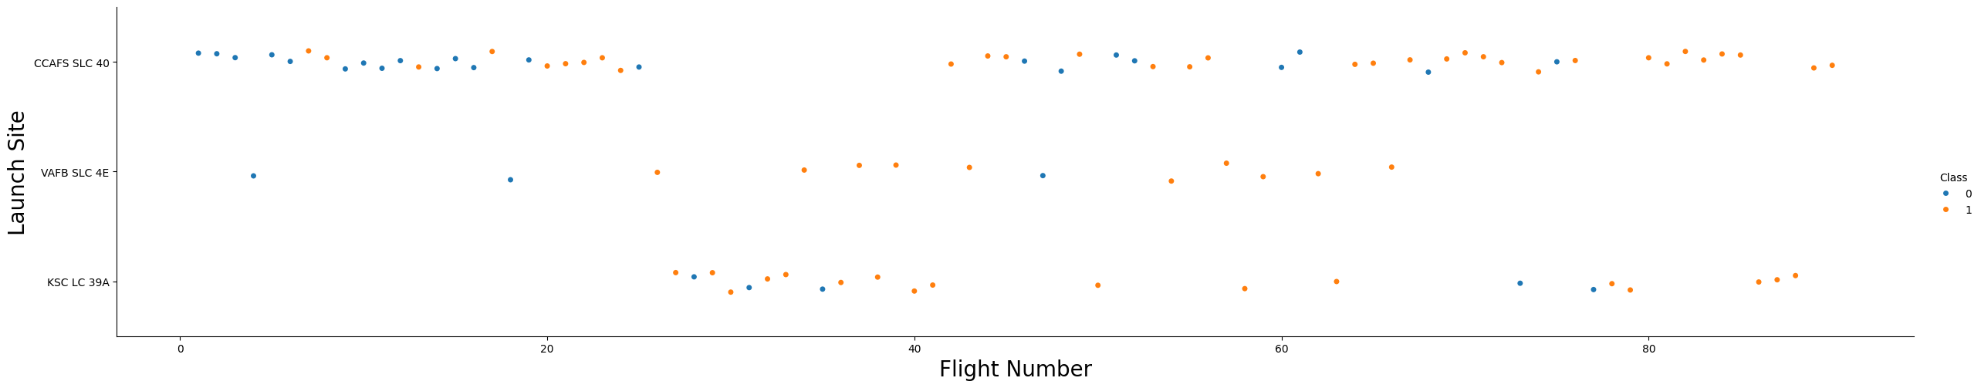
Flight Number vs. Launch Site
The scatter plot shows the distribution of flight numbers across different launch sites.
CCSFS SLC-40 and KSC LC-39A are the most frequently used sites.
VAFB SLC-4E has fewer launches, mainly for polar orbits.

Slide 24
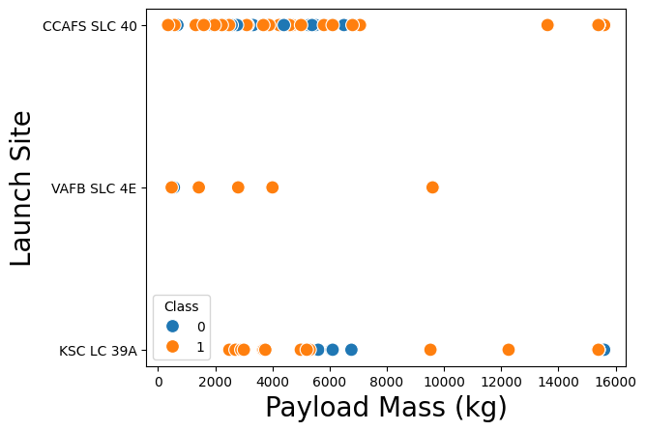
Payload vs. Launch Site
The scatter plot illustrates the payload mass variations for each launch site.
KSC LC-39A supports the broadest range of payloads, including the heaviest ones.
CCSFS SLC-40 also handles various payload sizes but with slightly lower upper limits.

Slide 25
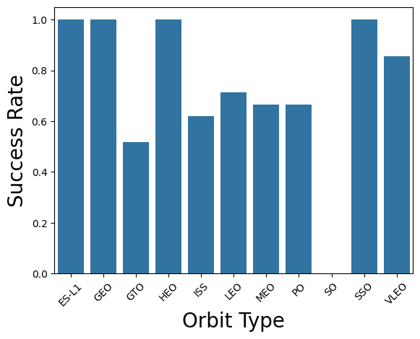
Success Rate vs. Orbit Type
The bar chart shows the landing success rate for different orbit types.
ES-L1, GEO, HEO and SSO has the highest success rate.
LEO, MEO and PO has a moderate success rate, reflecting higher energy requirements.
GTO and ISS have lower-mid success rates, while SO has the lowest success rate.

Slide 26
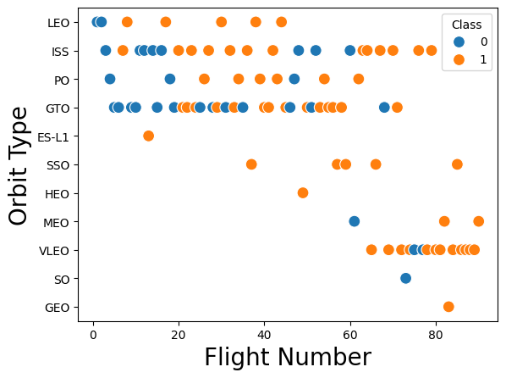
Flight Number vs. Orbit Type
The scatter plot reveals how launch frequency varies across orbit types.
ISS and GTO launches dominate.
SSO, HEO, MEO, SO and GEO remain the lowest in launches.

Slide 27
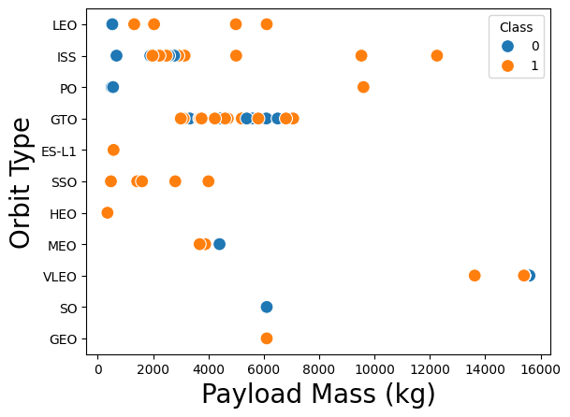
Payload vs. Orbit Type
Heavier payloads are primarily sent to VLEO and ISS.
ISS involves in carrying lower Payload too ranging from 2000kg to 8000kg.
GTO carries especially medium weight payloads.

Slide 28
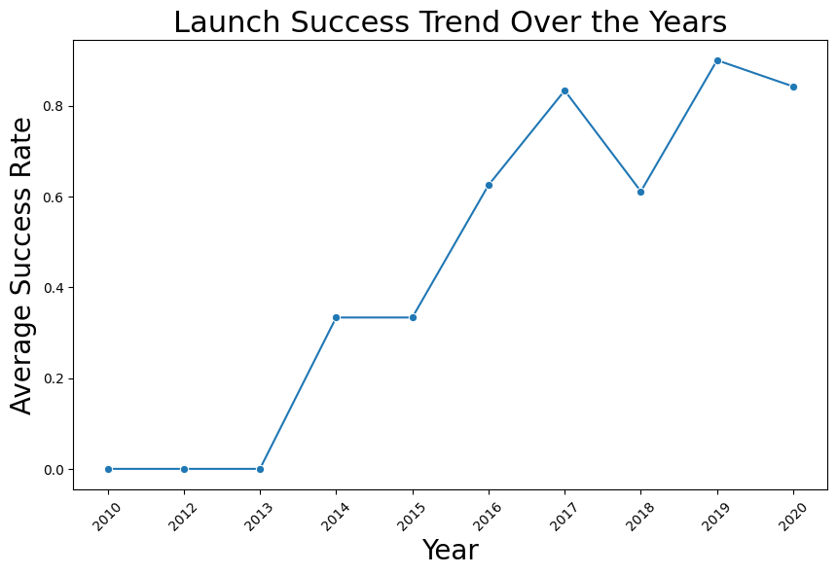
Launch Success Yearly Trend
The line chart demonstrates an increasing trend in launch success over time.
Improvements in booster reusability contribute to higher success rates.

Slide 29
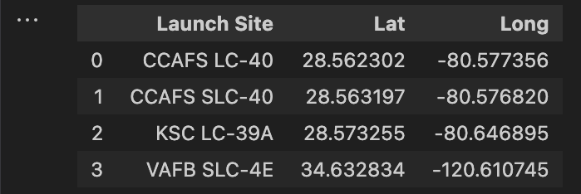
All Launch Site Names
The query retrieves all distinct launch site names.
The results indicate that launches are primarily conducted at KSC LC-39A, CCAFS LC-40, CCSFS SLC-40, and VAFB SLC-4E.

Slide 30
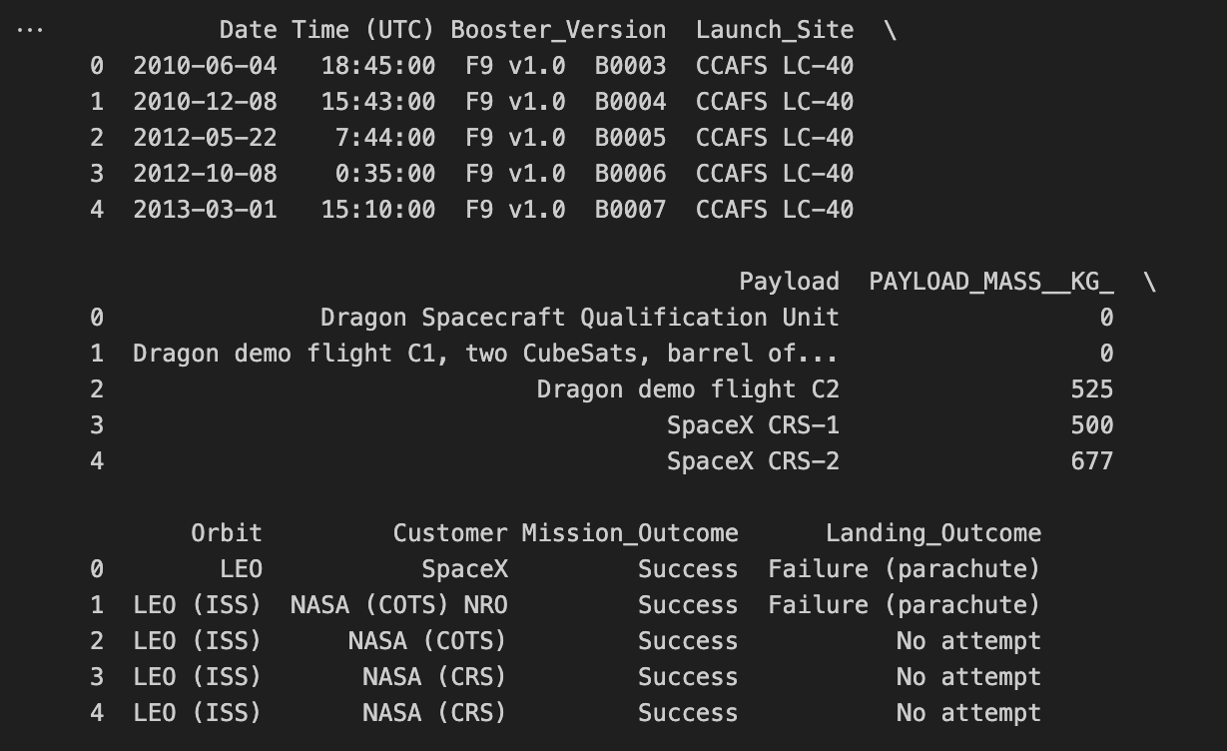
Launch Site Names Begin with 'CCA'
This query filters launch sites that start with 'CCA'.
The result confirms that CCSFS SLC-40 is the only site matching this condition.

Slide 31
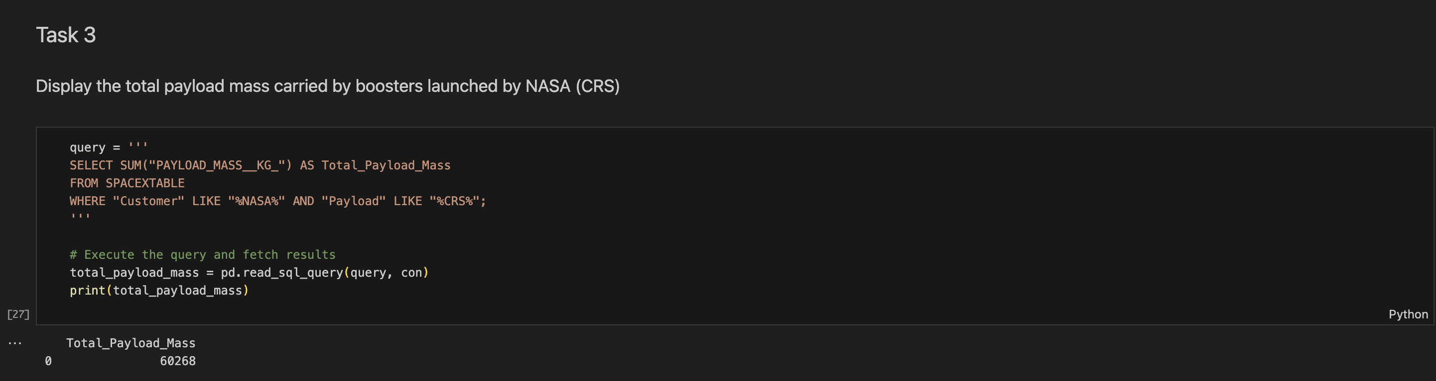
Total Payload Mass
The query calculates the total payload mass launched by NASA.
The result shows that NASA has launched a total payload of 60,268 kg.

Slide 32
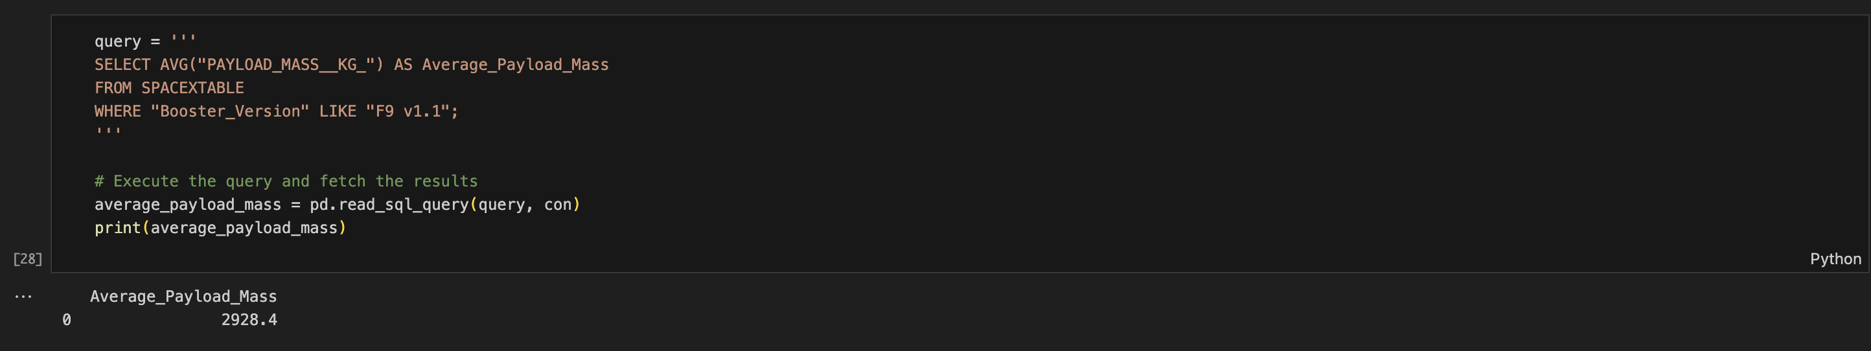
Average Payload Mass by F9 v1.1
This query computes the average payload mass for missions using the F9 v1.1 booster version.
The result shows an average payload mass of 2928.4 kg.

Slide 33
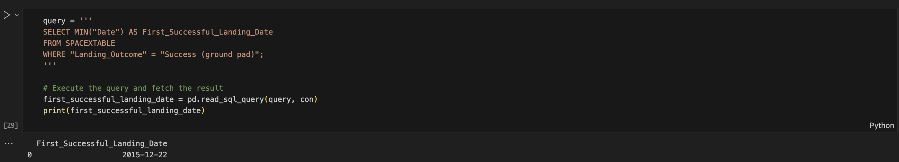
First Successful Ground Landing Date
The query retrieves the first recorded successful landing on a ground pad.
The result indicates that the first successful ground landing occurred on 2015-12-21.

Slide 34
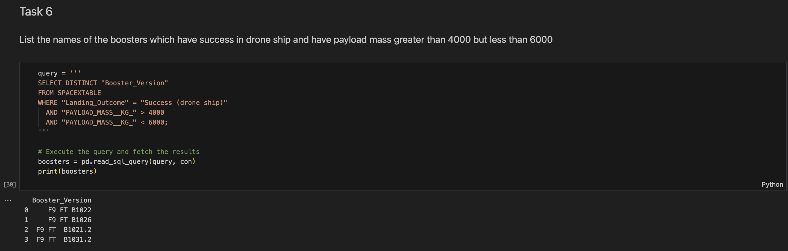
Successful Drone Ship Landing with Payload between 4000 and 6000
The query filters successful drone ship landings where the payload mass falls between 4000 and 6000 kg.
The result lists boosters B1022, B1026, B1021.2, and B1031.2 as having met these criteria.

Slide 35
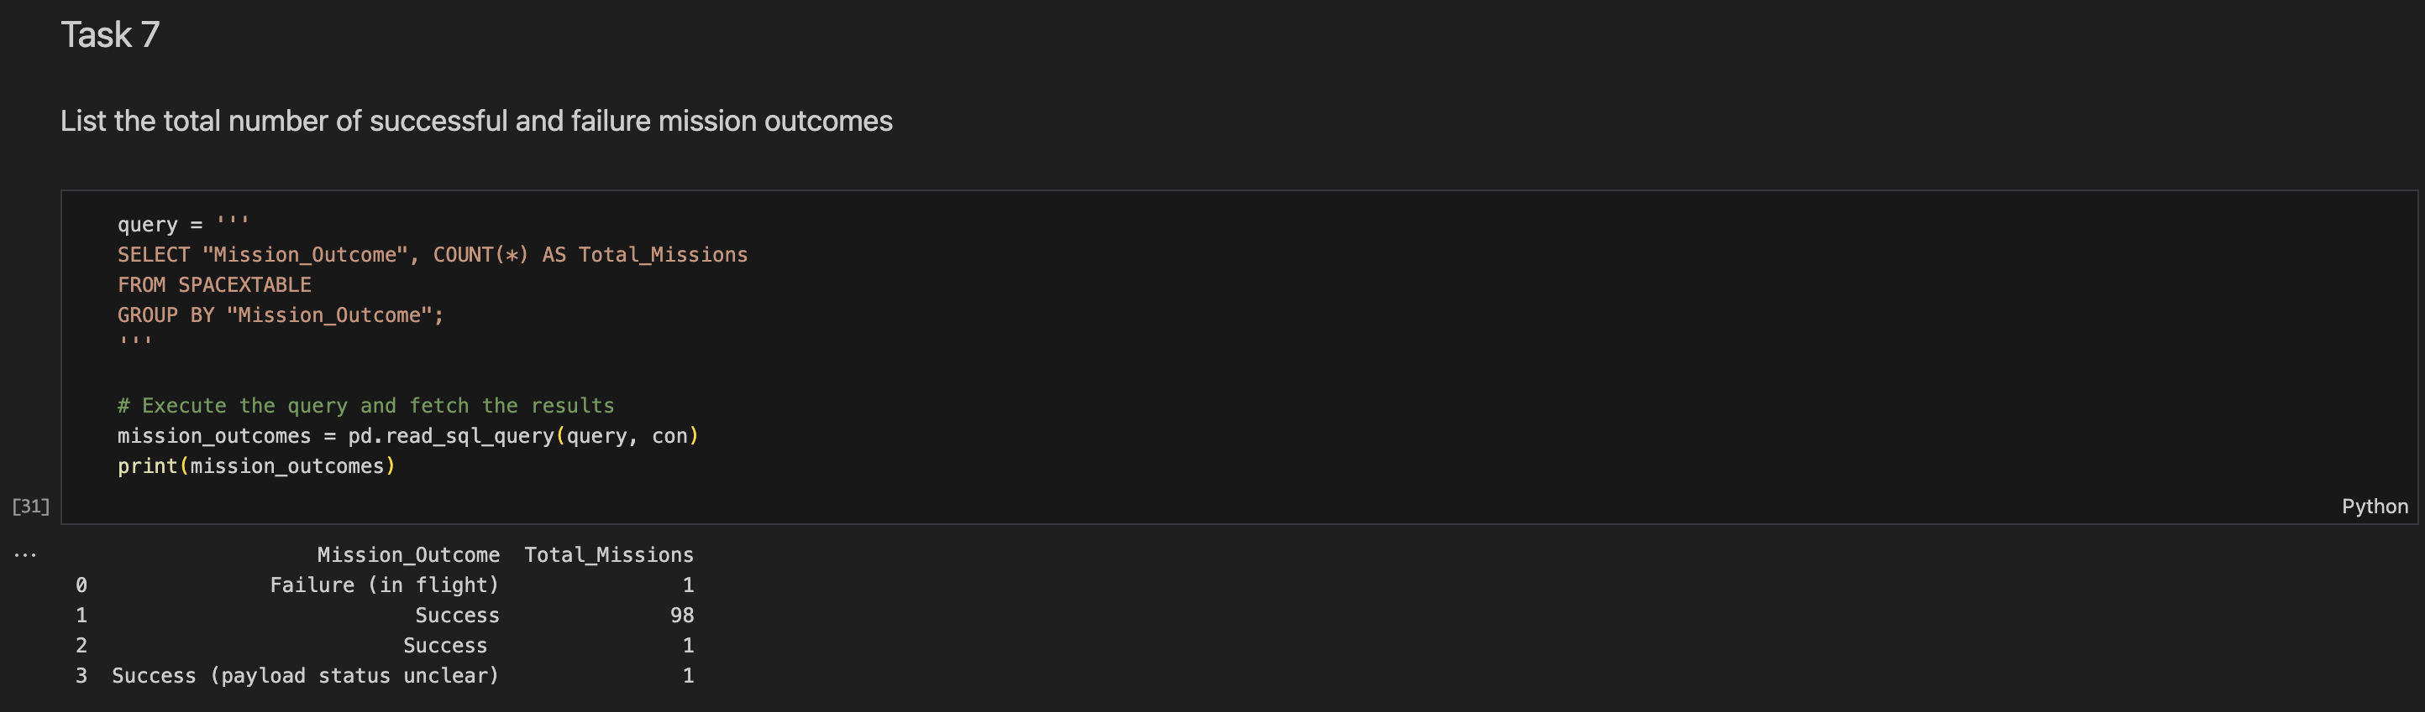
Total Number of Successful and Failure Mission Outcomes
This query counts the total number of successful and failed missions.
The results show 99 successful missions, 1 successful mission with payload status unclear, and 1 failures (in flight).

Slide 36
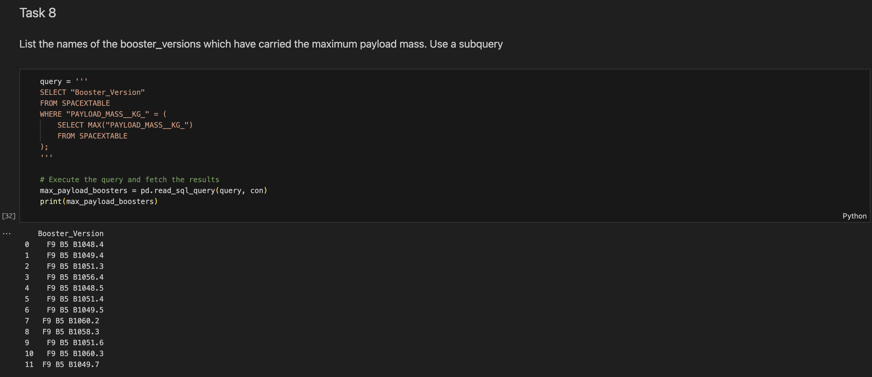
Boosters Carried Maximum Payload
This query identifies the boosters that carried the maximum payload mass.
The result indicates that boosters B1048.4, B1049.4, B1051.3, B1056.4, and many more carried the maximum payload.

Slide 37
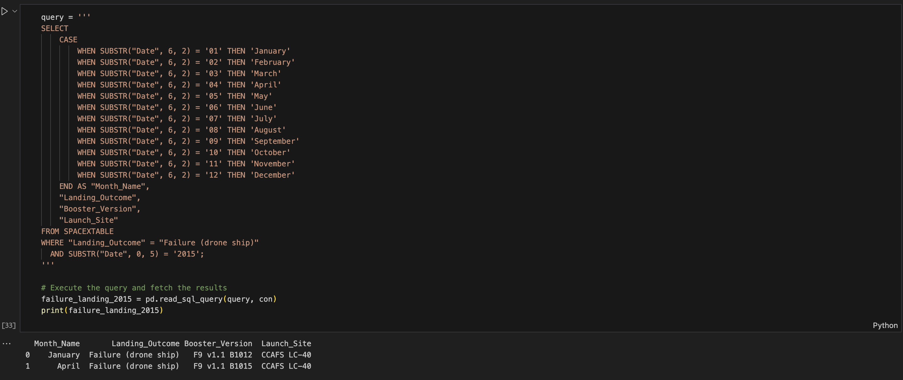
2015 Launch Records
This query retrieves failed drone ship landings in 2015.
The results show that boosters B1012 and B1015 failed, both launching from CCAFS LC-40.

Slide 38
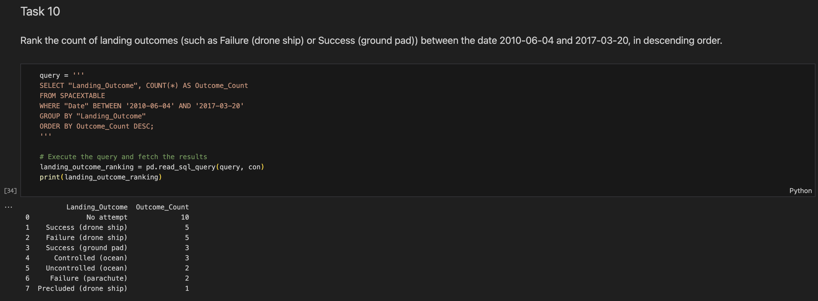
Rank Landing Outcomes Between 2010-06-04 and 2017-03-20

Slide 39
Rank Landing Outcomes Between 2010-06-04 and 2017-03-20
This previous query ranks landing outcomes from 2010 to 2017.
The most frequent outcomes are:
No attempt: 10 times
Success (drone ship): 5 times
Failure (drone ship): 5 times
Success (ground pad): 3 times
Controlled (ocean): 3 times
Uncontrolled (ocean): 2 times
Failure (parachute): 2 times
Precluded (drone ship): 1 time

Slide 40

Section 3

Slide 41
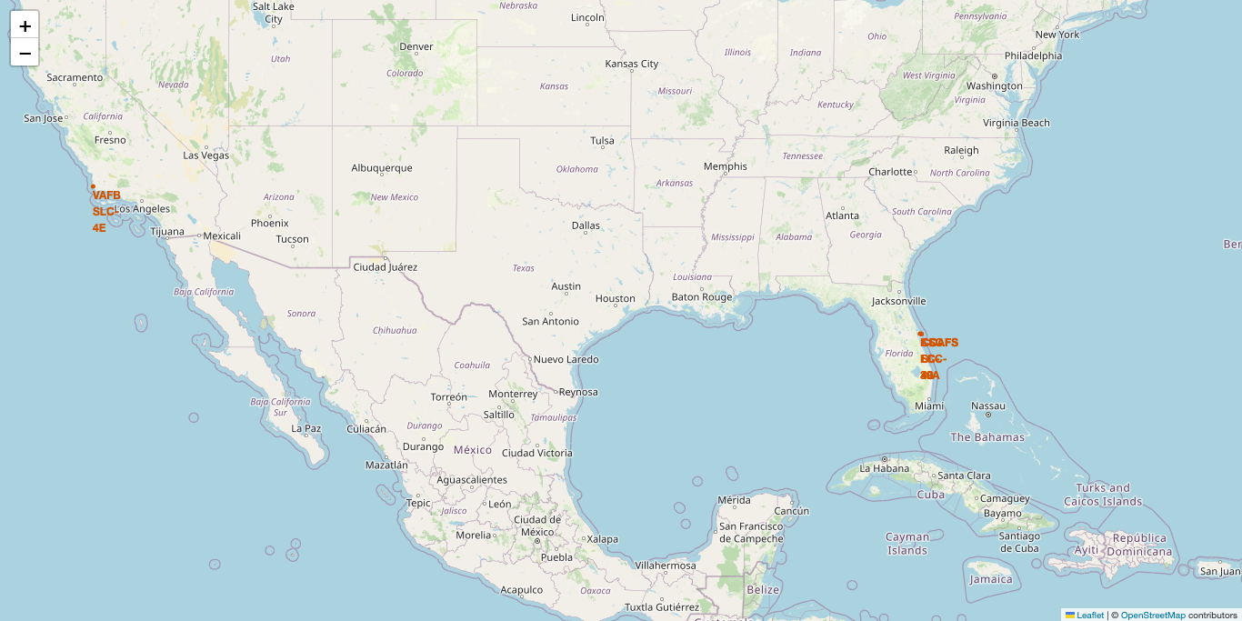
All SpaceX Launch Sites

Slide 42
All SpaceX Launch Sites
Key Elements:
Based on the Folium map, we can see that all launch sites are either in Florida or California.
The Florida launch sites are positioned for equatorial and geostationary launches, benefiting from the Earth's rotation.
The California launch site (VAFB) is ideal for polar orbits, used for Earth observation and reconnaissance missions.
Key Findings:
KSC LC-39A is one of the most significant launch sites, used for Falcon 9 and Falcon Heavy missions.
SLC-40 and CCAFS are frequently used for commercial and government payloads.
VAFB SLC-4E is specialized for polar or sun-synchronous orbits, primarily for satellites.

Slide 43
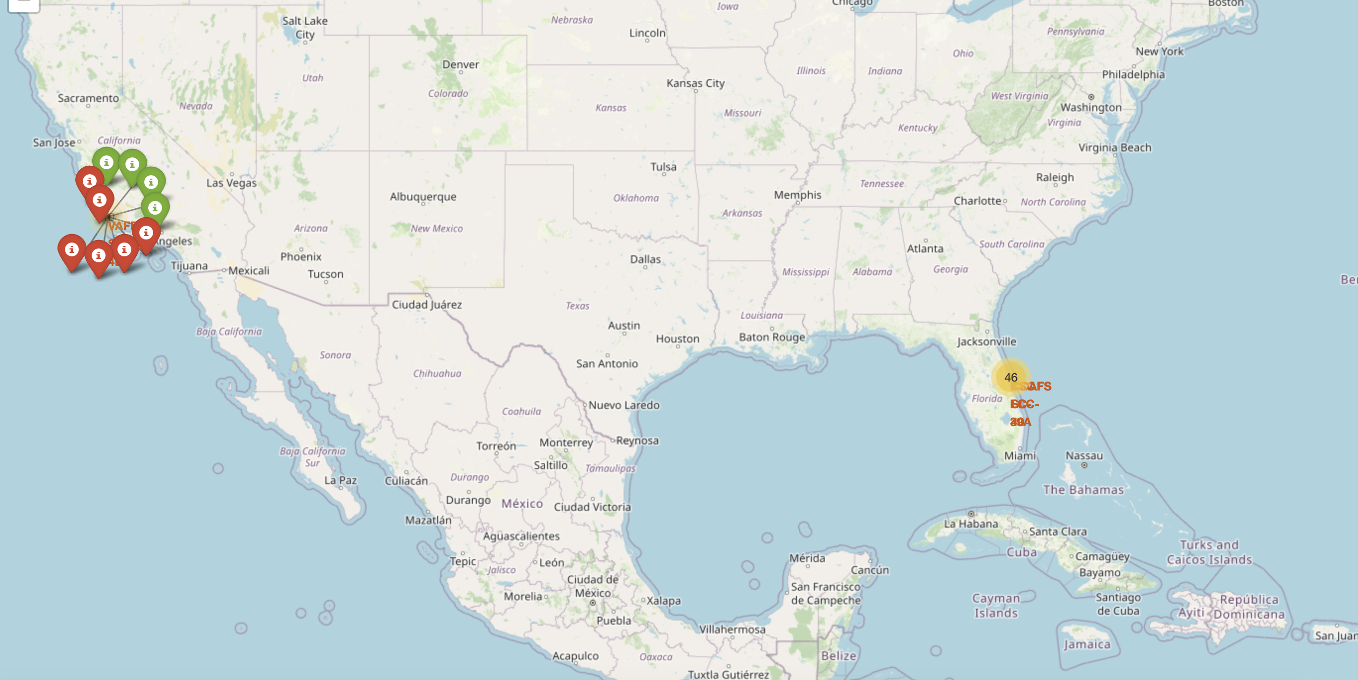
Color Labeled Launch Outcomes

Slide 44
Color Labeled Launch Outcomes
Key Elements in the Screenshot:
Markers Representing Launch Outcomes:
Red markers indicate failed launches or anomalies.
Green markers indicate successful launches.
The California sites have a mix of outcomes, possibly due to higher-risk missions.
The color-coded markers provide an instant visual cue of SpaceX's success rate over time.

Slide 45
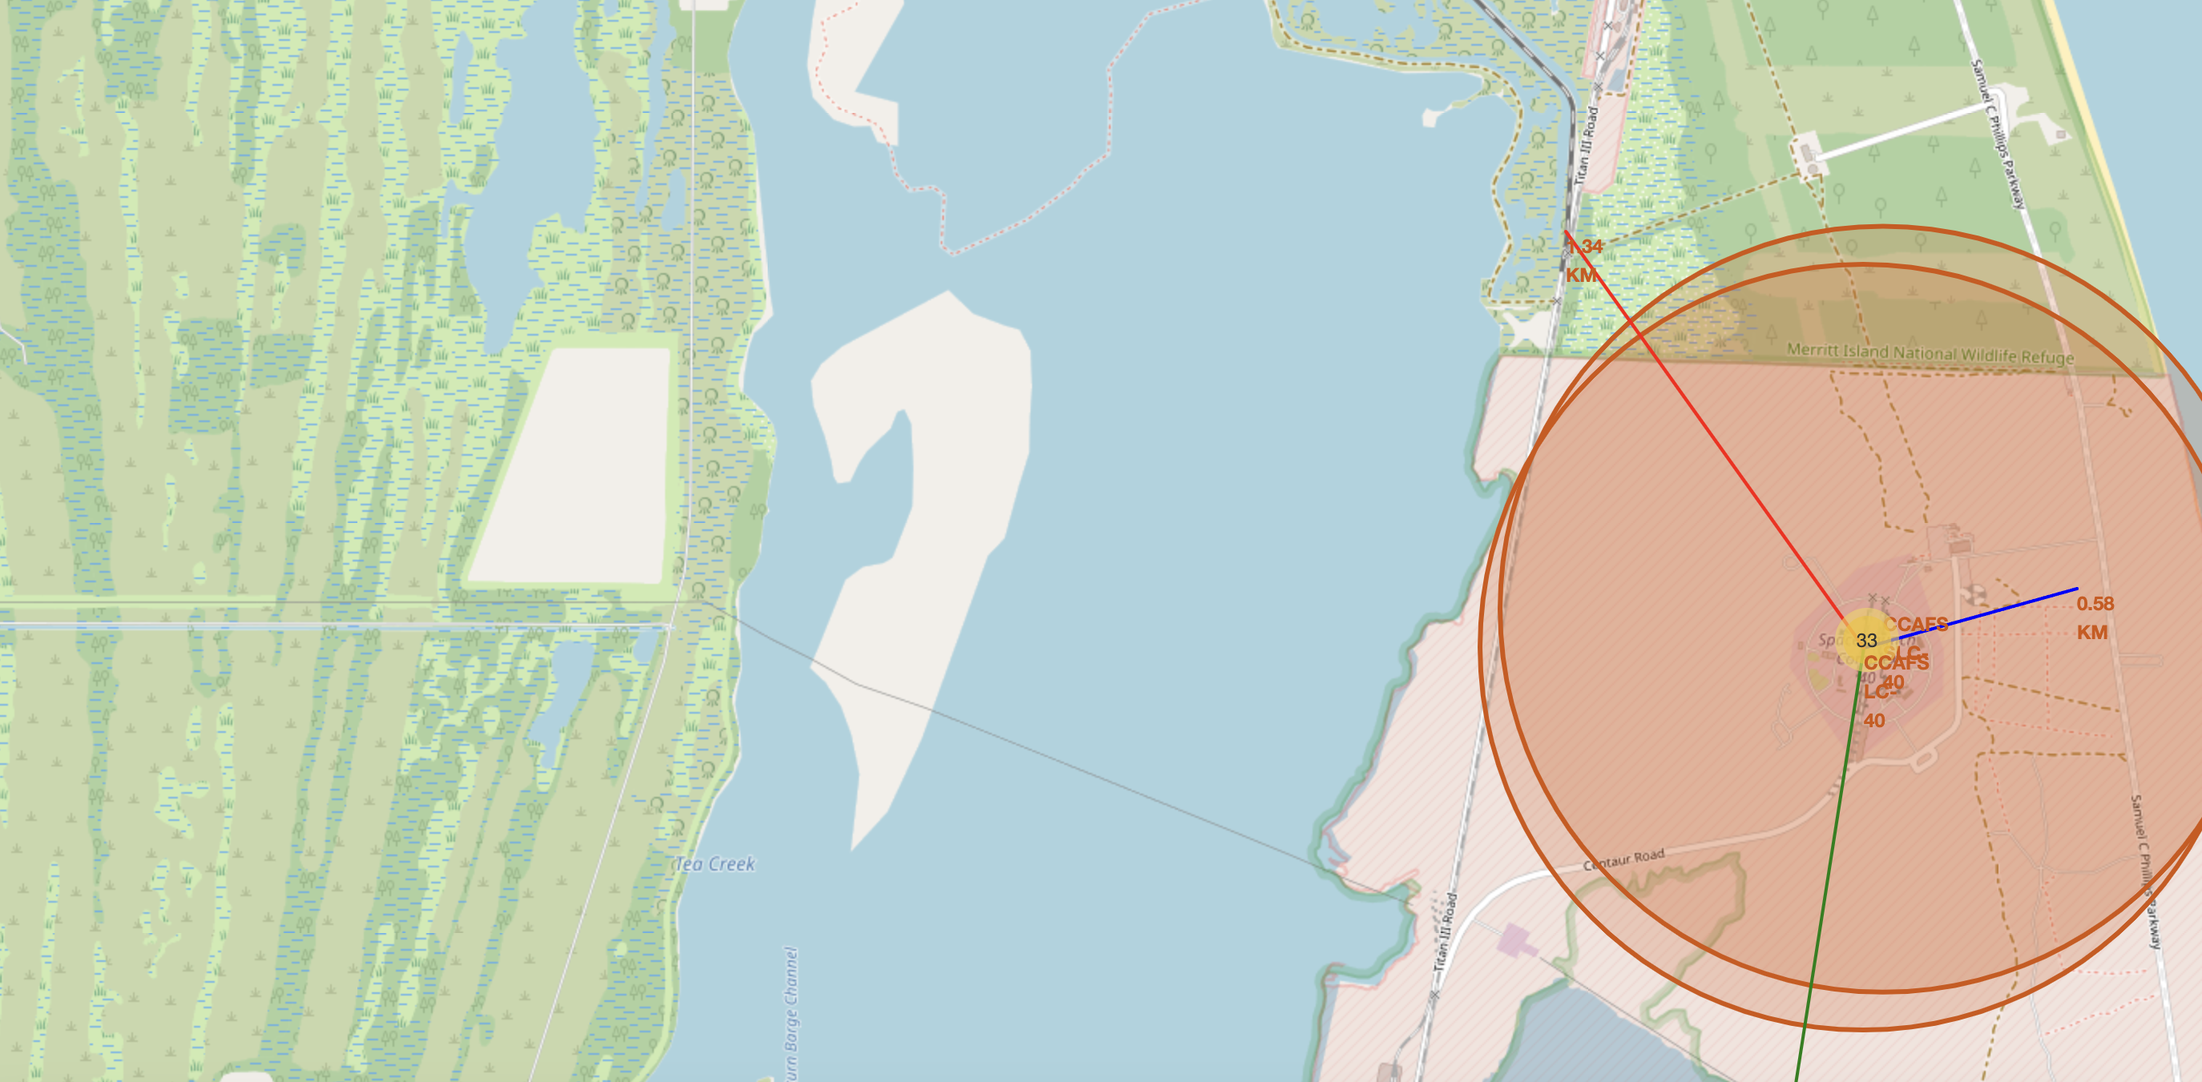
Launch Sites With Proximities (Railway)

Slide 46
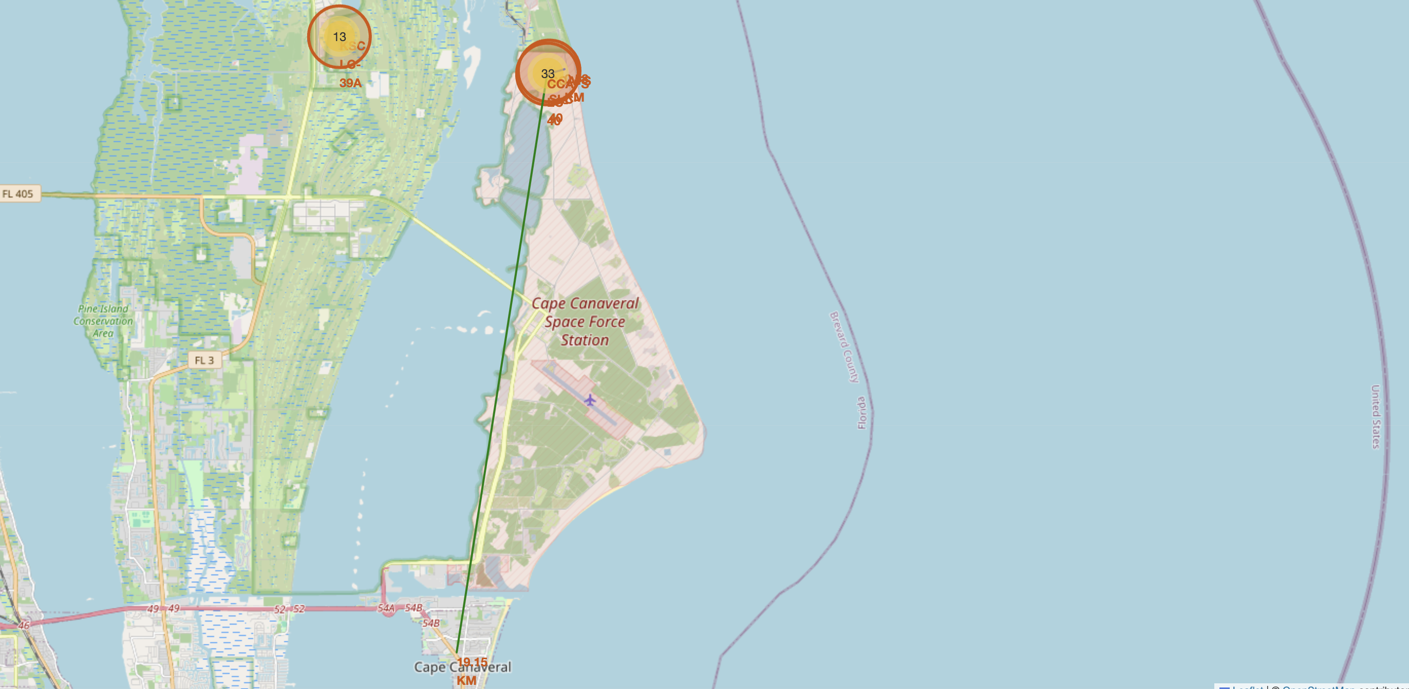
Launch Sites With Proximities (City)

Slide 47
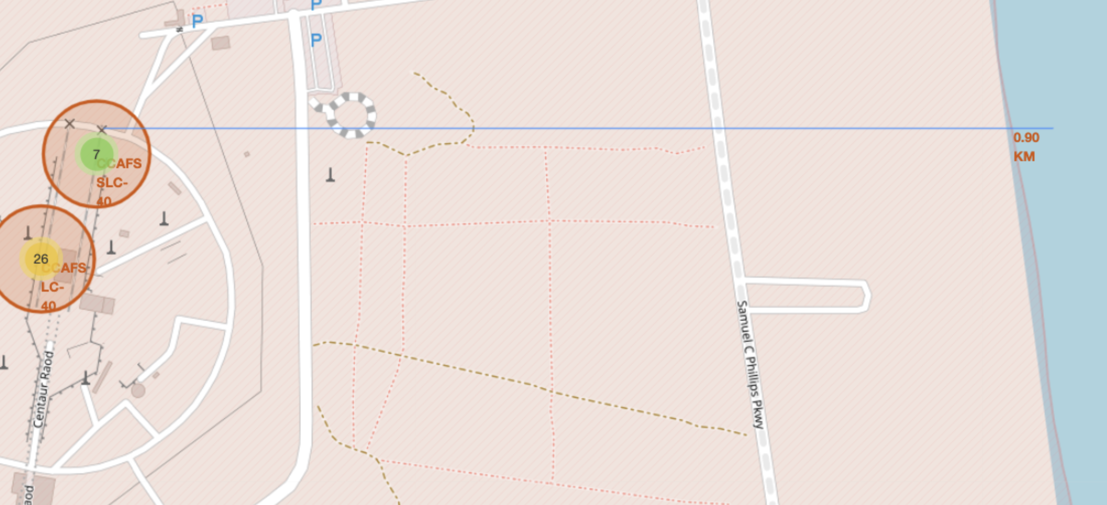
Launch Sites With Proximities (Coastline)

Slide 48
Launch Sites With Proximities
Findings from the Folium Map:
Railway Proximity: The map visualizes the distance from the launch site to the nearest railway. Close railway access might be relevant for transporting materials.
City Proximity: The calculated distance from launch sites to closest city shows connectivity for logistics.
Coastline Proximity: Most launch sites are near coastlines, likely to reduce risks to populated areas.

Slide 49

Section 4

Slide 50
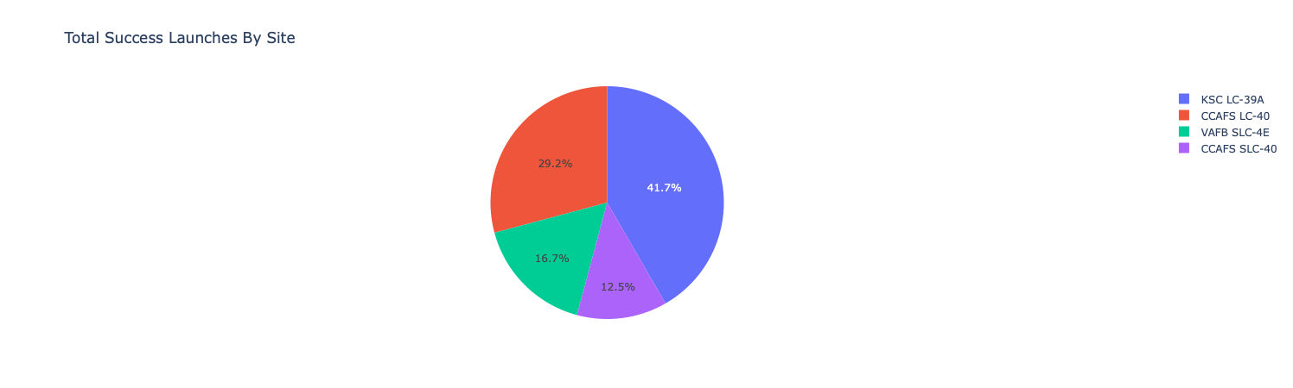
Total Success Launches By Site

Slide 51
Total Success Launches By Site
Key Findings:
KSC LC-39A (41.7%) has the highest number of successful launches, making it the most frequently used and successful site.
CCAFS LC-40 (29.2%) follows as the second most successful site.
VAFB SLC-4E (16.7%) and CCAFS SLC-40 (12.5%) have fewer successful launches compared to the first two sites.
The distribution suggests that launches are concentrated mainly at KSC LC-39A and CCAFS LC-40, while the other sites play a smaller role.

Slide 52
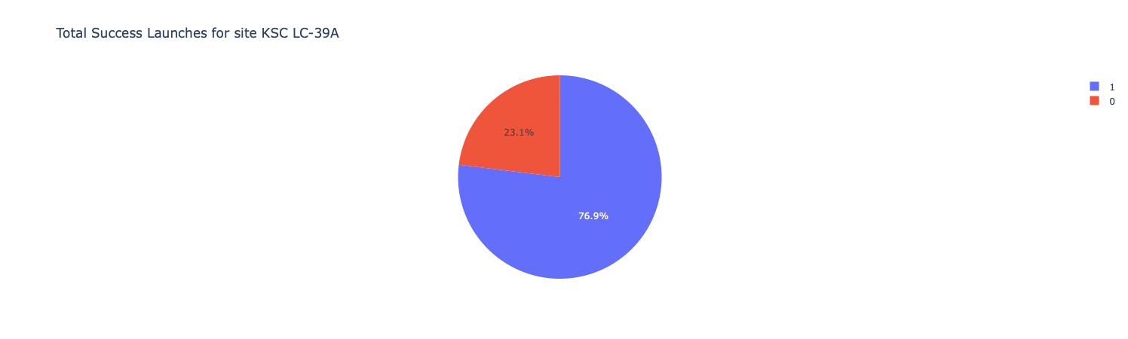
Launch Site With Highest Launch Success Ratio

Slide 53
Launch Site With Highest Launch Success Ratio
Key Findings:
KSC LC-39A has the highest launch success ratio among all sites.
With 76.9% success, this site demonstrates strong reliability for SpaceX launches.
The 23.1% failure rate suggests that while the site is highly successful, there is still room for improvement.

Slide 54
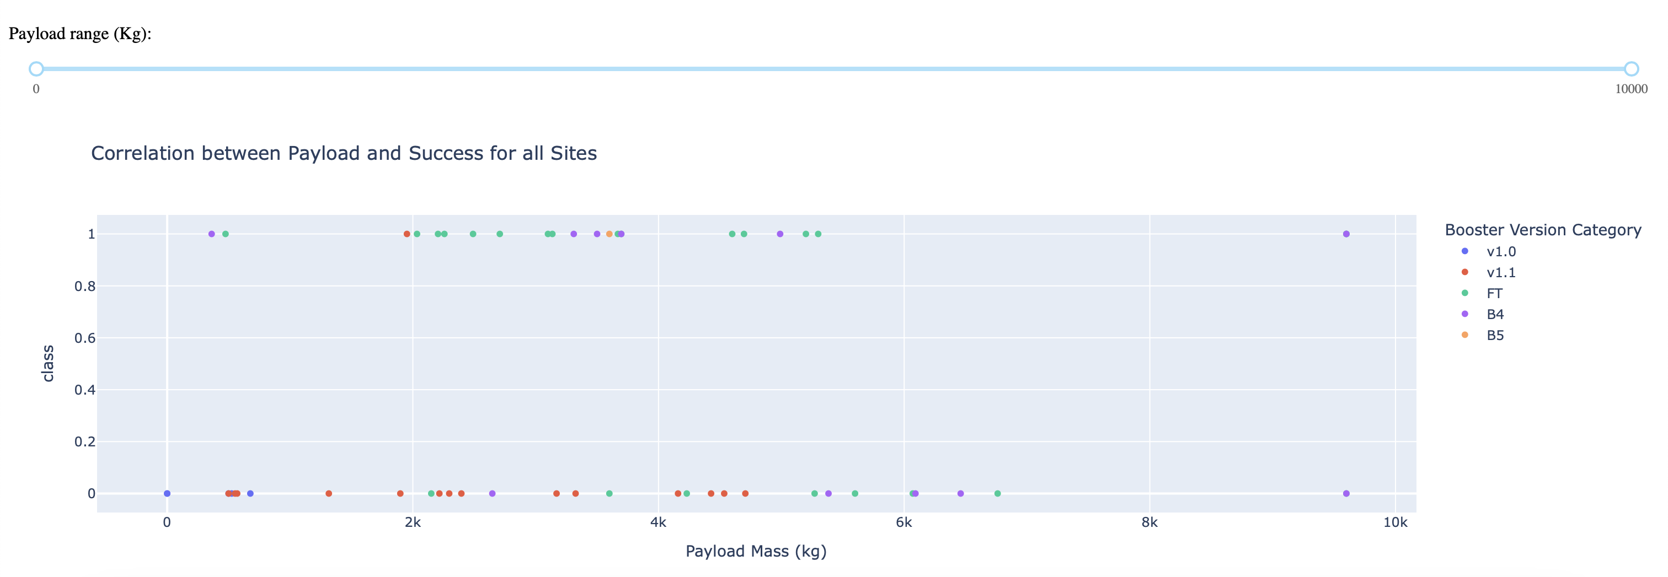
Payload vs Launch Outcome Scatter Plot
Above is a screenshot of correlation between Payload and Success for all sites.

Slide 55
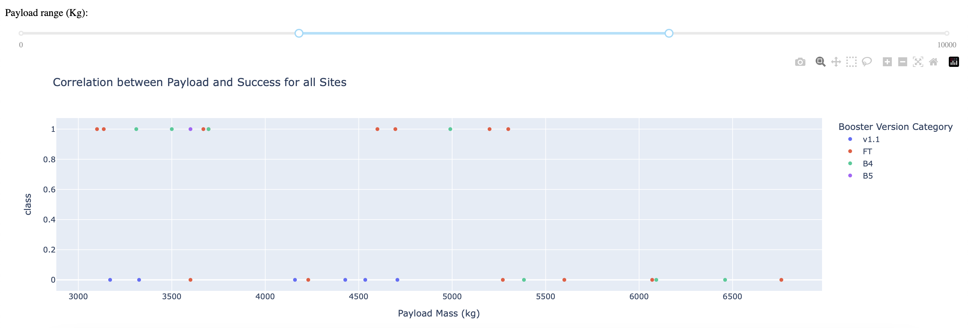
Payload vs Launch Outcome Scatter Plot
Above is a screenshot of correlation between Payload and Success for all sites, with different payload selected in the range slider.

Slide 56
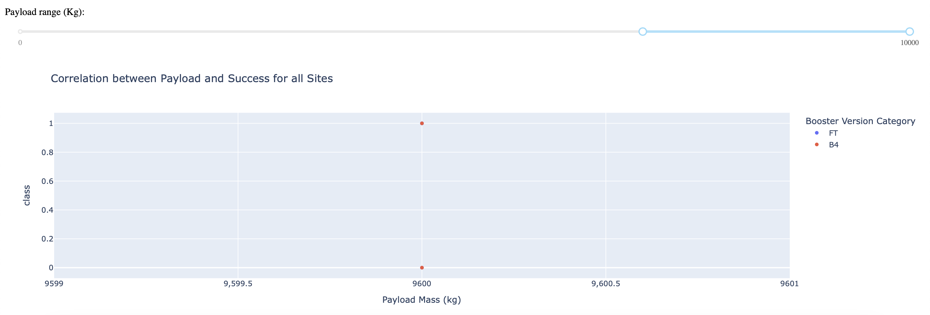
Payload vs Launch Outcome Scatter Plot
Above is a screenshot of correlation between Payload and Success for all sites, with different payload selected in the range slider, this time in the higher end of the spectrum.

Slide 57
Payload vs Launch Outcome Scatter Plot
Key Findings:
Boosters with the Highest Success Rate:
The FT (green), B4 (purple), and B5 (orange) boosters seem to have a high success rate, with most of their points located at class 1 (successful launches).
The v1.0 (blue) and v1.1 (red) versions show more failures, with several points at class 0.
Payload Mass vs. Success:
Smaller payloads (below ~2000 kg) show both successes and failures, suggesting mixed reliability in this range.
Medium payloads (2000–6000 kg) mostly have successful launches, especially with newer boosters.
Larger payloads (above 6000 kg) show a few failures, suggesting a higher challenge for very heavy payloads.
Best Performing Booster Versions:
FT, B4, and B5 boosters show better success rates, even at higher payloads.

Slide 58
Payload vs Launch Outcome Scatter Plot
Conclusion:
FT, B4, and B5 boosters are the most reliable, achieving high success rates.
Smaller payloads have mixed success, while very large payloads are more likely to fail.
v1.0 and v1.1 are less reliable, showing a higher failure rate.

Slide 59

Section 5

Slide 60
Classification Accuracy
A visualization of all model’s accuracy score is available on the right side.
Based on the results, we can conclude that the model based on ”Decision Tree” was the most accurate among all.

Slide 61
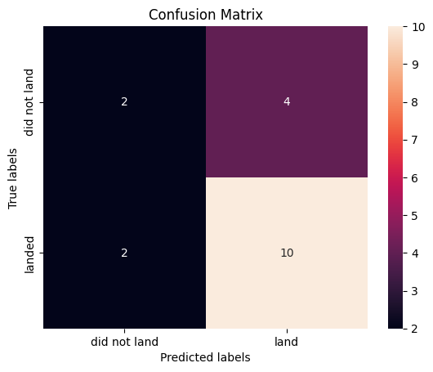
Confusion Matrix
In this confusion matrix, I analyzed the performance of the “Decision Tree” model in predicting rocket landings:
 | Predicted: Did Not Land | Predicted: Landed
Actual: Did Not Land | 2 (True Negative) | 4 (False Positive)
Actual: Landed | 2 (False Negative) | 10 (True Positive)

Slide 62
Confusion Matrix
Key Metrics:
True Positives (TP = 10): The model correctly predicted that the rocket landed.
True Negatives (TN = 2): The model correctly predicted that the rocket did not land.
False Positives (FP = 4): The model incorrectly predicted that the rocket landed.
False Negatives (FN = 2): The model incorrectly predicted that the rocket did not land.
Model Performance Insights:
The model correctly classifies 12 out of 18 cases.
There are 4 false positives, meaning the model tends to overestimate landings.
There are 2 false negatives, meaning it sometimes misses actual landings.
Since the model has more false positives than false negatives, it leans toward overpredicting landings rather than missing them.

Slide 63
Conclusions
Key Findings from the Analysis
Landing Success Factors:
Booster Reusability: Reused boosters (e.g., FT, B4, B5) showed higher success rates (76.9% at KSC LC-39A) compared to older versions (v1.0, v1.1).
Payload Mass: Medium payloads (2000–6000 kg) correlated with higher success rates, while very heavy payloads (>6000 kg) increased failure risk.
Launch Sites: KSC LC-39A (Florida) and CCSFS SLC-40 achieved the highest success rates, while VAFB SLC-4E (California) specialized in polar orbits with moderate success.
Temporal Trends:
Success rates improved significantly over time, reflecting advancements in booster recovery technology and operational experience.

Slide 64
Conclusions
Key Findings from the Analysis
Predictive Model Performance:
Decision Tree emerged as the best-performing model (highest accuracy) for predicting landing success. Key features included payload mass, orbit type, and booster version.
Interactive Insights:
Folium maps and Plotly Dash dashboards revealed geographic trends, payload/outcome relationships, and mission frequency by site.

Slide 65
Appendix
Include any relevant assets like Python code snippets, SQL queries, charts, Notebook outputs, or data sets that you may have created during this project

Slide 66


